Slide 1
RCE High Fidelity Prototype
By Rupinder Kaur and AounEMuhammad

Slide 2
Sitemap
Homepage
About Us
Things to do
Local Projects
Contact US
Thought of the day
Register/Login
Search

Slide 3

Homepage
Video to Play
Tag Line
Sask Motto
SDG in bottom left
Sask Map in bottom right
RCE Sask logo on top right corner

Slide 4
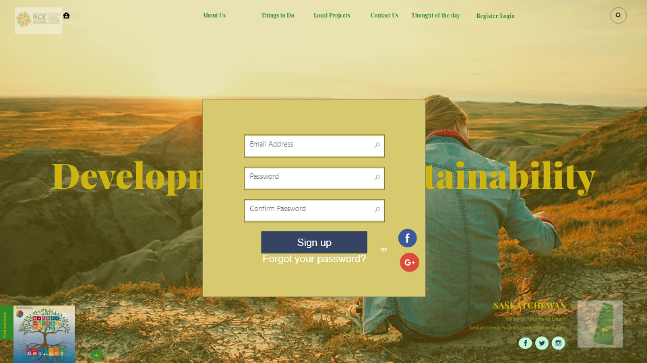
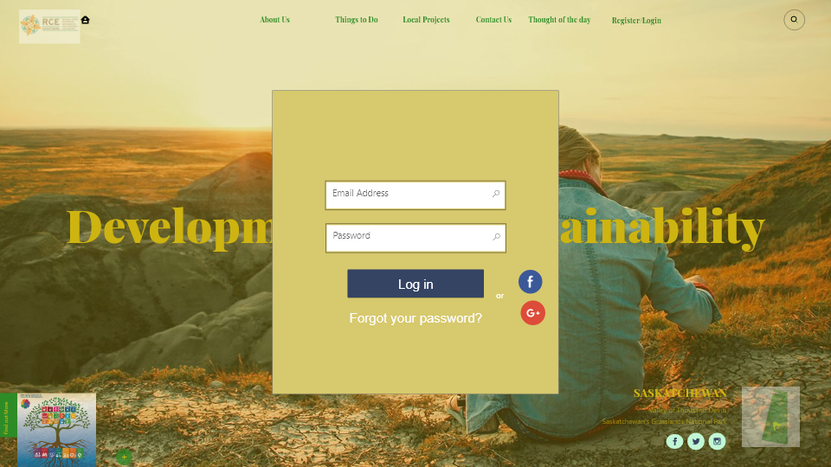
Register
Email/password
Option to register with facebook/gmail
Verification mail/OTP (next slide)

Slide 5
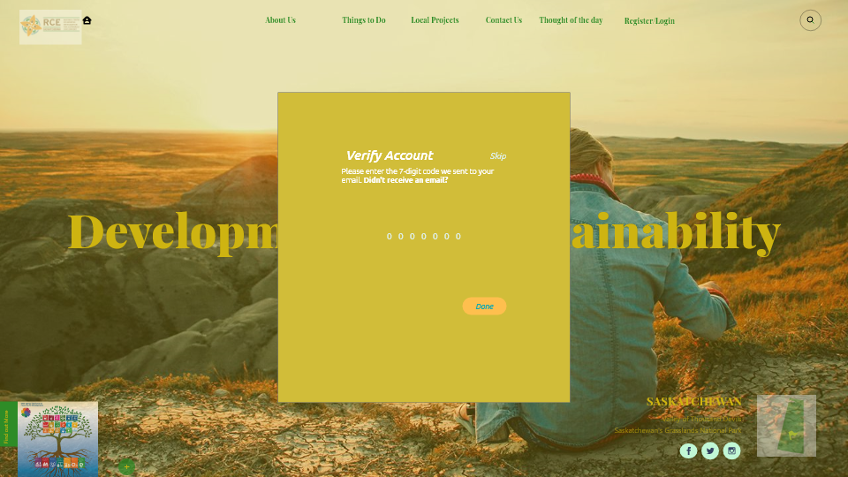

Verification

Slide 6
About US
-About Us (2)
-News and Events (201)
-Our Strategic Directions (202)

Slide 7

About Us
What We Do
News and Events ->
Our Team
Our Impact -> SDG
Highlights of previous years

Slide 8
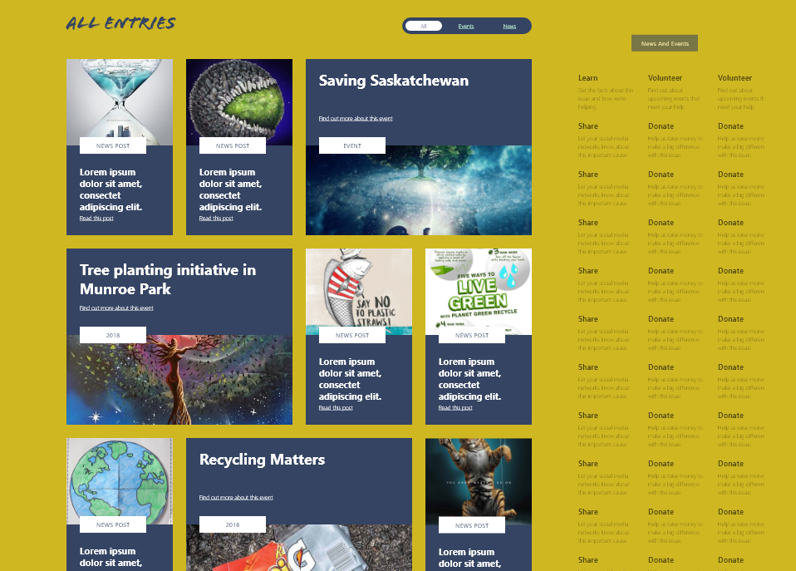
News and Events
News with captions and thumbnails
On the right, navigation bar to go through other news

Slide 9

Our Impact – Strategic Directions
SDG goals with summary -> Detailed outline after clicking read more

Slide 10
Things to Do
Volunteering ->(302(0), 302(1)
- Library (3, , 303(0), 303(1), 303(2))

Slide 11
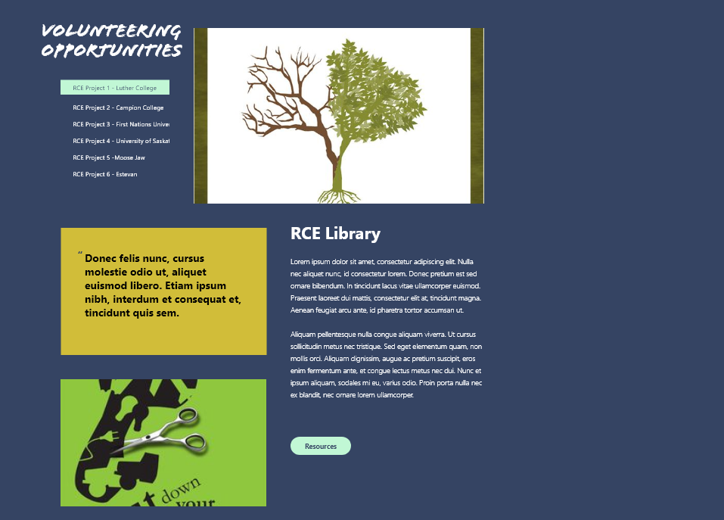
Things to Do
Volunteering
RCE Library
Blogs

Slide 12

Volunteering Signup
Signing up for volunteer activities
Information required for EOI

Slide 13

Volunteering EOI Submission Screen
Confirmation mail sent for EOI
Option to share the coming event on social media as well

Slide 14
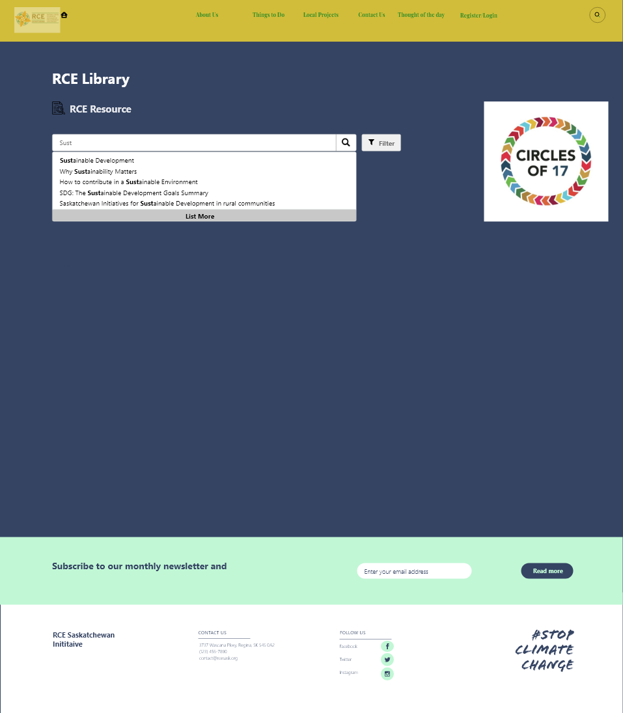
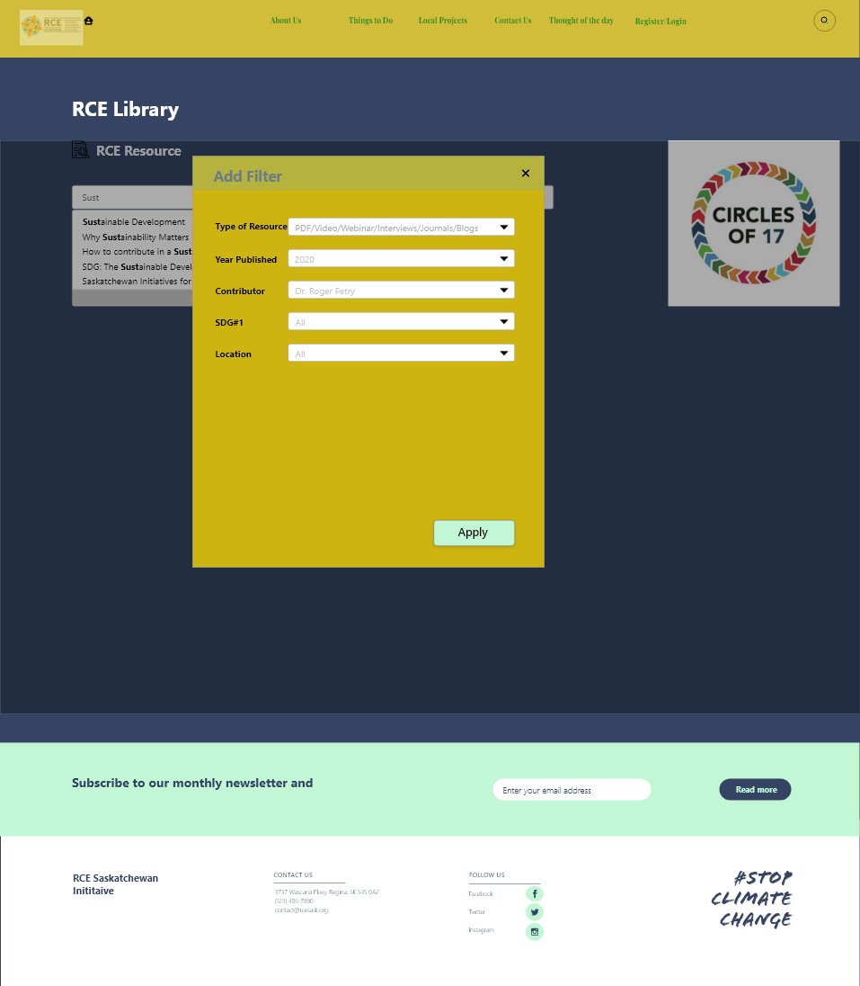
RCE E-Library

Slide 15
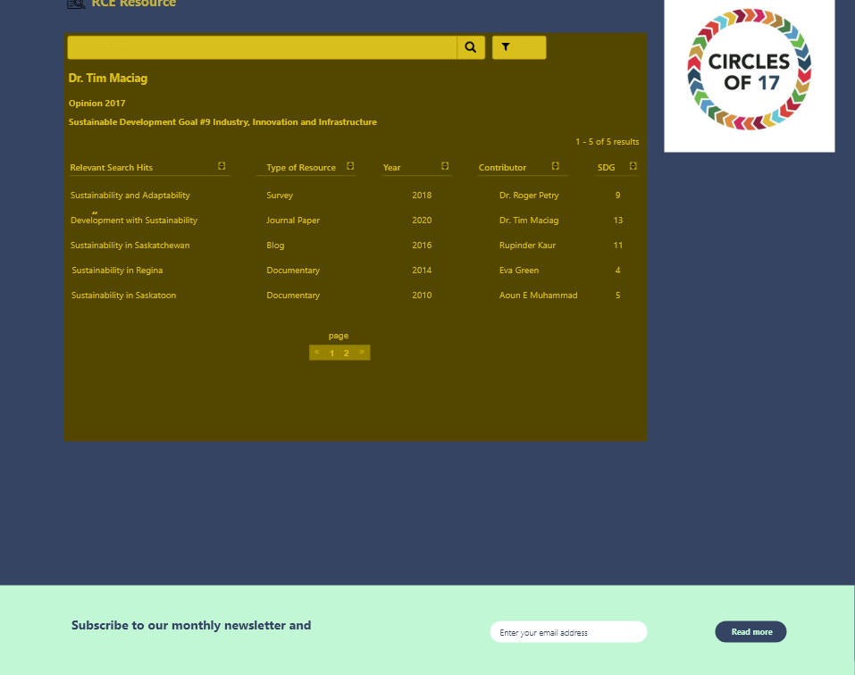
RCE E-Library Search Screen
RCE Library Search options instead of overwhelming the reader/visitor with information
Resources filtered by SDG number, Type of resource (Journal, Book, Interview, Webinar, Blog, Documentary), year and contributor

Slide 16
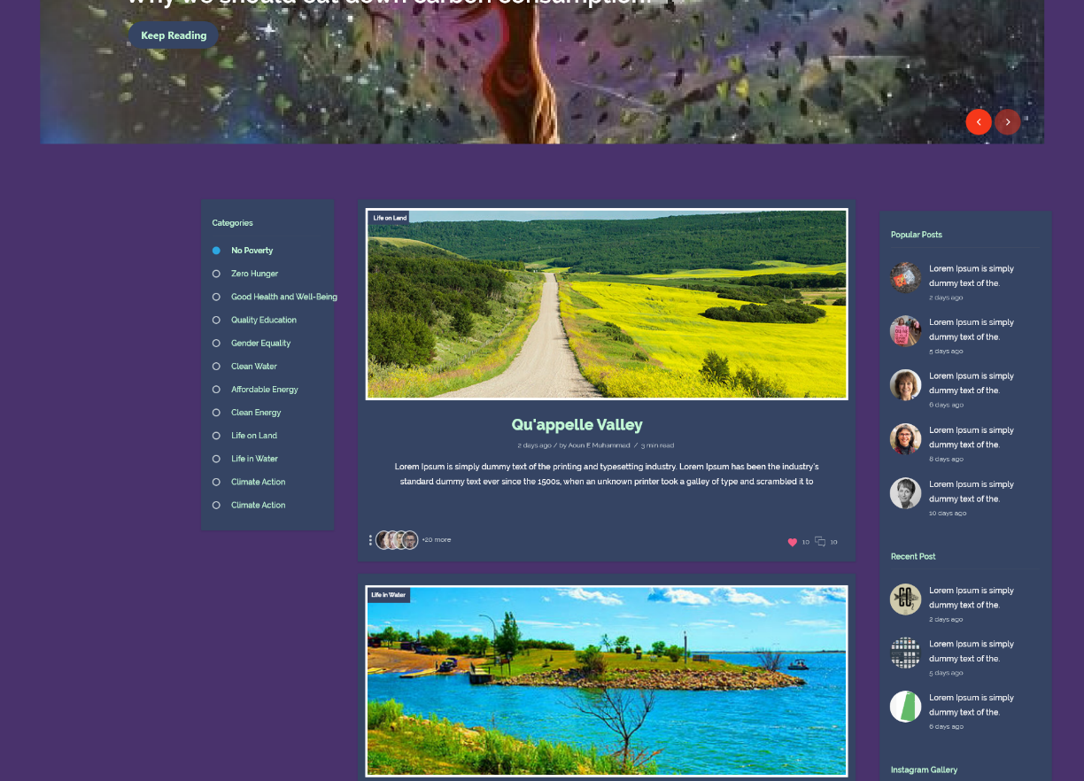
Blogs
Blog Page
Option to browse by categories
Popular and recent posts on the left
Blogs categorized by SDG tag as well (optional)
Author’s name, length of the article read (in mins)
Likes, comments allowed for members, share allowed for public

Slide 17
Local Projects
Local Projects- >
-Local Projects (5)

Slide 18

Local Projects
Summary of the projects done in recent past or currently going
Click to see the details
Or Next story to browse for others

Slide 19
Thought of the Day
Thought of the day

Slide 20

Thought of the Day
Infographics to raise awareness

Slide 21
Thanks

